Slide 1

Vocab-Lookup
VocabLookup is a bilingual dictionary lookup tool to assist ESL users with their English readings
Notes:
NOTE:
To change the image on this slide, select the picture and delete it. Then click the Pictures icon in the placeholder to insert your own image.

Slide 2
Background Story
VocabLookup is a bilingual dictionary lookup tool to assist ESL users with their English readings
Many readers want to read for pleasure with no intention to enhance their vocabulary. When encountering unfamiliar words, frequently using a directory not only time consuming but also kills the joy of reading. It’s especially true for those No Native Englisher Speakers like my parents.
This summer my mom decided to read a New York best selling book called “Where the Crawdads Sing”. Even she is fluent in English, but it’s still quite challenge for her to read the book due to so many unfamiliar words in the book; she had to constantly use Google Translator to translate these words in her native language. Frequently word lookup disrupted her reading rhythm and eventually discouraged her from continuing to read the book.
Many ESL readers have the similar struggle as my parents do. To help them enjoying readings without spending too much time on the directory, I developed VocalLookup App to perform dictionary lookup only once per article, which could be online or local doc; then the retrieved challenge words will be persisted on reader’s personal device as flashcards; Many readers couldn’t retain the definition of words after looking up, these flashcards could help readers to refresh their memory with vocabularies during their readings.

Slide 3
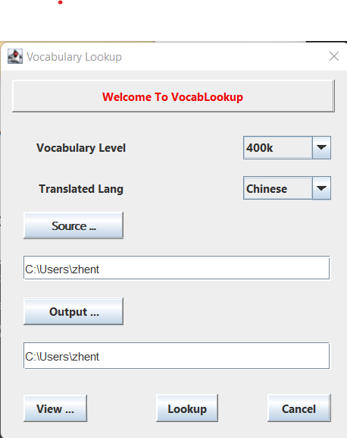

VocalLookup App Demo

Slide 4
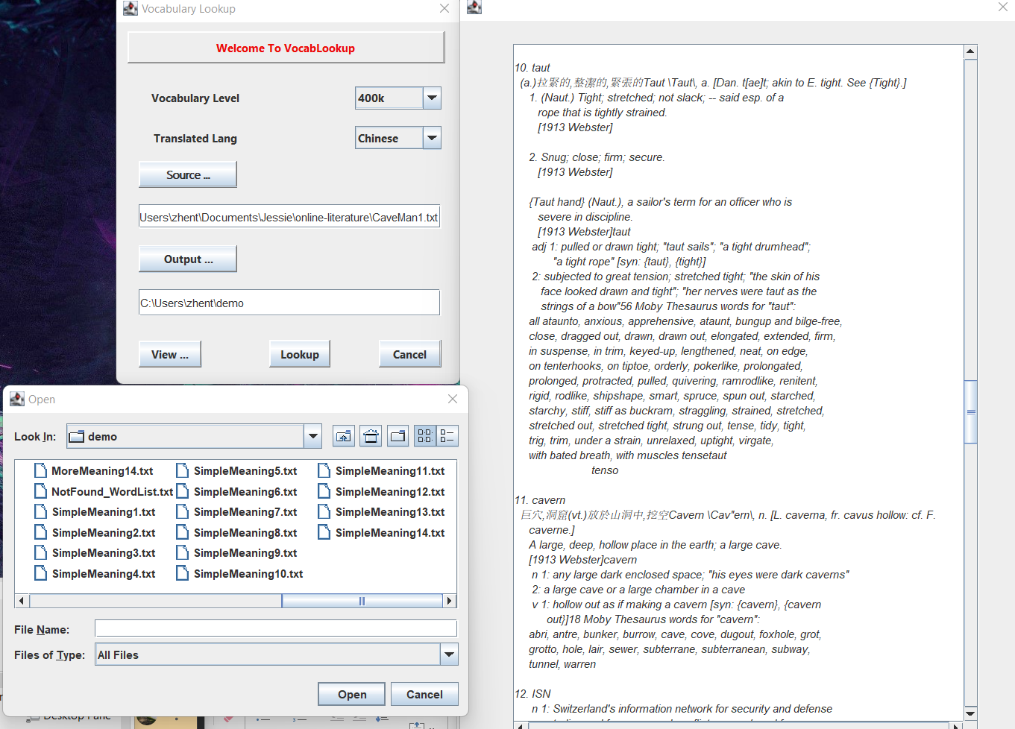
VocabLookup App Screen Capture

Slide 5
VocabLookup Features
The standalone application provides an efficient way to do vocabulary lookup for the article of ESL reader’s choice either from internet or local device
Scan and Translate: The application scans an article to perform vocabulary search based on the reader's English vocabulary level, it collects and translates challenge words into the reader's native language of choice (Note: currently scope only supports English to Chinese translation).
Flashcard: The challenge words are then saved on the device as files (with three categories : simple meaning, more meaning and detailed meaning ) to be used as flashcards for reference or vocabulary practice.
Consolidate: The tool consolidates past historic challenge words into a list stored as a file to be viewed by ESL readers to build vocabulary.

Slide 6
Technology Stack
IDE: IntelliJ
Language: Java, XML, UML
Framework: JFormDesigner, GUI Builder, Maven

Slide 7
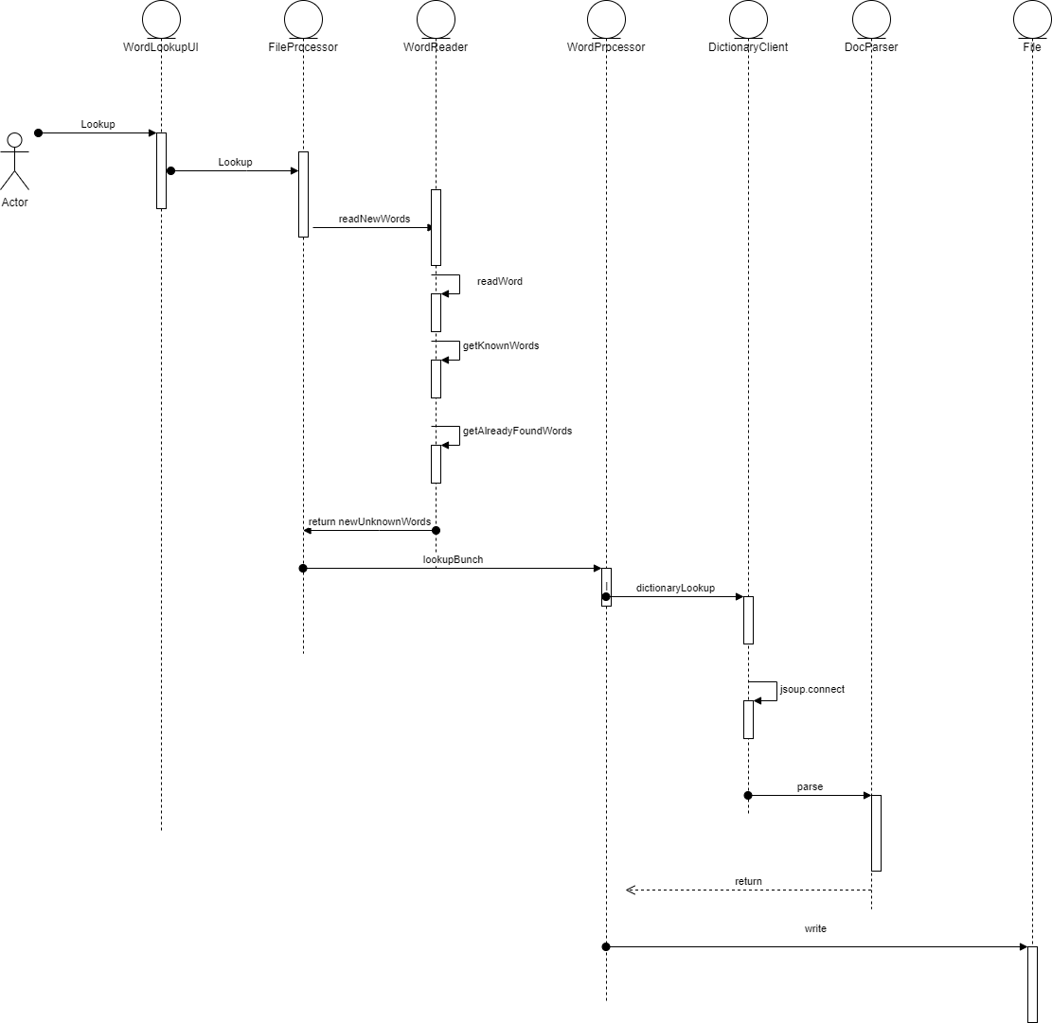
Implement Logic

Slide 8

Conclusion
Thank You!

